Slide 1
^{DSI Capstone} ^{10/17 Weekly Update}
Oct 20, 2022

Slide 2
Agenda
1
Project Recap
2
Modeling Deep Dive: Classification
3
Modeling Deep Dive: Optimization
4
Modeling Deep Dive: Transfer Learning
5
Next Steps

Slide 3
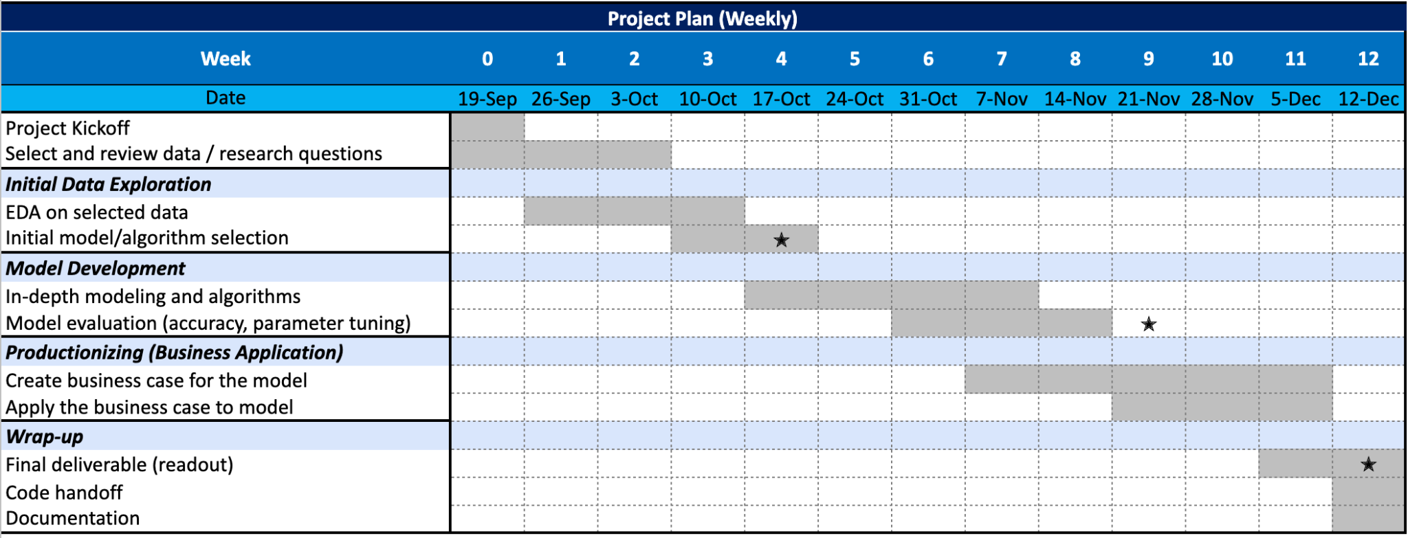
Project Recap: Timeline
1
1st progress report

Slide 4
Project Recap: defined research question
1
What are the most important factors to consider when choosing EV charging locations in Washington state? Where are potential optimal locations?
A
Why WA
i. WA has comparatively more EV registered and not severely lacking EV stations¹ for us to build models on
ii. WA has enough government-issued data available: https://data.wa.gov/
iii. WA has supporting policies for EVs
EVSE Grants support deployment projects along the state’s highway corridors
EVs and EVSE are eligible for a sales and use tax exemption
Commercial Alternative Fuel Vehicle and Fueling Infrastructure Tax Credit
AFVs are exempt from state emissions control inspections.
Green Public Transit Grant Program provides funding to install EV infrastructure among other green transportation projects

Slide 5
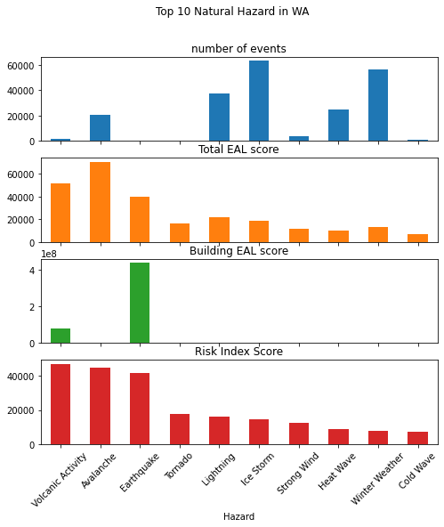
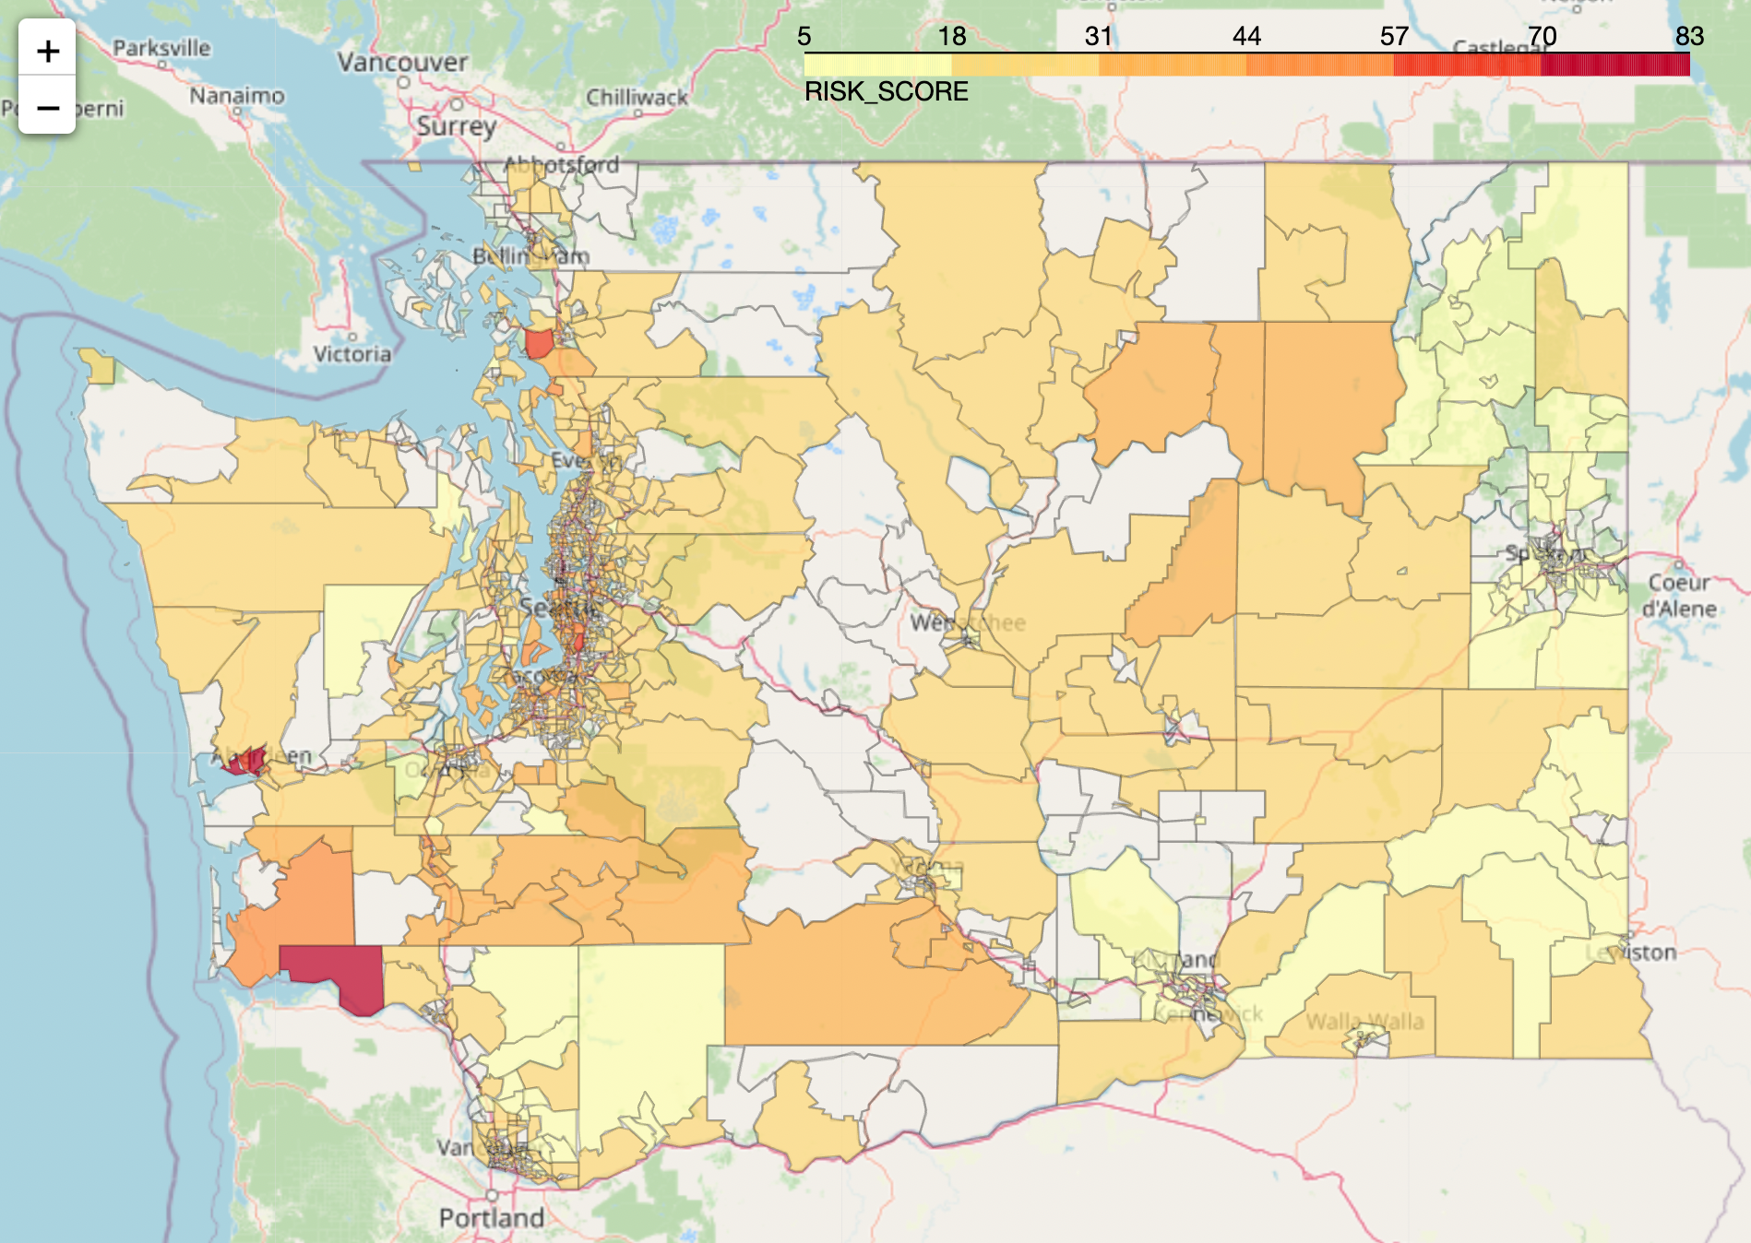
Project Recap: EDA - Natural Risk Index
Expected Annual Loss
Social Vulnerability
1
X
Washington's most common natural disasters include wildfires, floods, severe storms, landslides, earthquakes, tsunamis, droughts, and volcanoes.
Community Resilience
Natural Risk Index highly skewed by population, and property value.
Notes:
Washington's most common natural disasters include wildfires(WFIR), floods(CFLD: Coastal Flooding, RFLD: Riverine Flooding), severe storms(HRCN: Hurricane), landslides(LNDS), earthquakes(ERQK), tsunamis(TSUN), droughts(DRGT), and volcanoes(VLCN). Other less significant disasters include power outages, winter storms(CWAV: Cold Wave, WNTW: winter weather, ISTM: ice storm, HAIL: Hail, AVLN:Avalanche), and tornadoes(TRND). HWAV: Heat Wave
EAL: [Expected Annual Loss](https://hazards.fema.gov/nri/expected-annual-loss)
Expected Annual Loss (EAL) represents the average economic loss in dollars resulting from natural hazards each year. It is calculated for each hazard type and quantifies loss for relevant consequence types: buildings, people, and agriculture.
SOVI: [Social Vulnerability](https://hazards.fema.gov/nri/social-vulnerability) (Min-max normalized)
Social vulnerability is the susceptibility of social groups to the adverse impacts of natural hazards, including disproportionate death, injury, loss, or disruption of livelihood.
RESL: [Community Resilience](https://hazards.fema.gov/nri/community-resilience)
Community resilience is the ability of a community to prepare for anticipated natural hazards, adapt to changing conditions, and withstand and recover rapidly from disruptions.

Slide 6
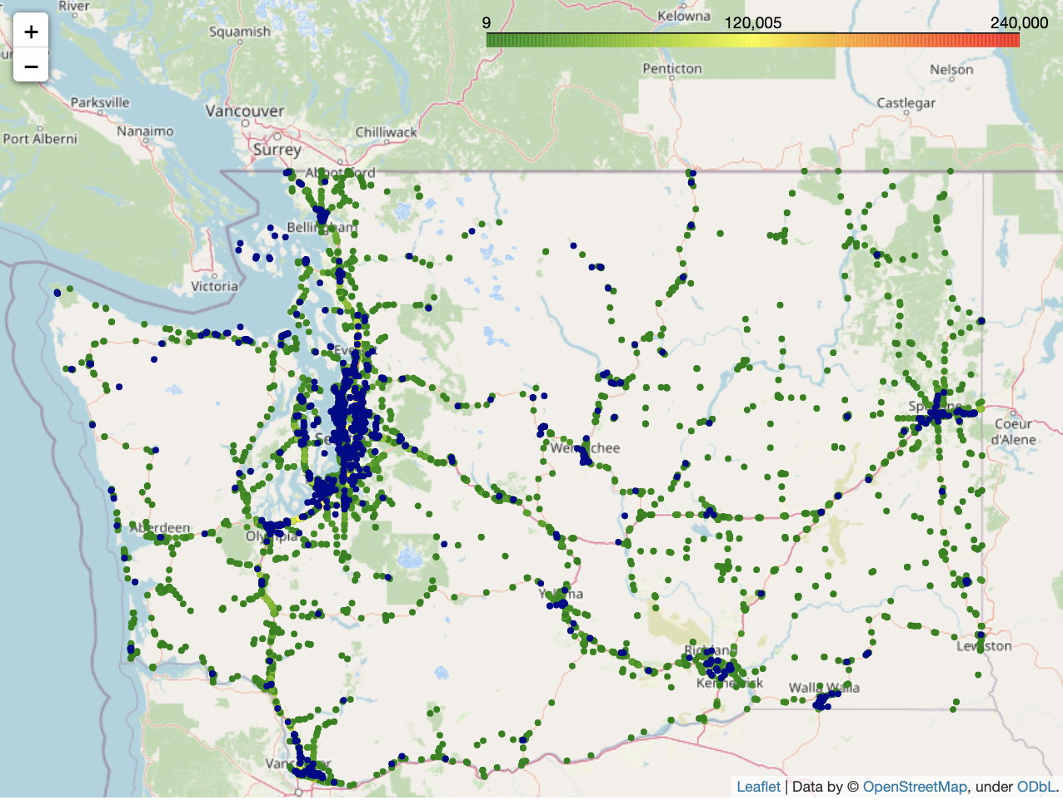
Project Recap: EDA - some areas accessible from Annual Average Daily Traffic are without enough EV stations
1
: EV charging stations
: annual average daily traffic
~1% of total annual average daily traffic (AADT)
Approximate total AADT in circled area: 1,716,549
~3% of total annual average daily traffic (AADT)
Approximate total AADT in circled area: 5,069,390
~4% of total annual average daily traffic
Approximate total AADT in circled area: 6,243,820
Notes:
plot ev stations along with traffic data, identified 3 areas with traffic but lacking EV chargers

Slide 7
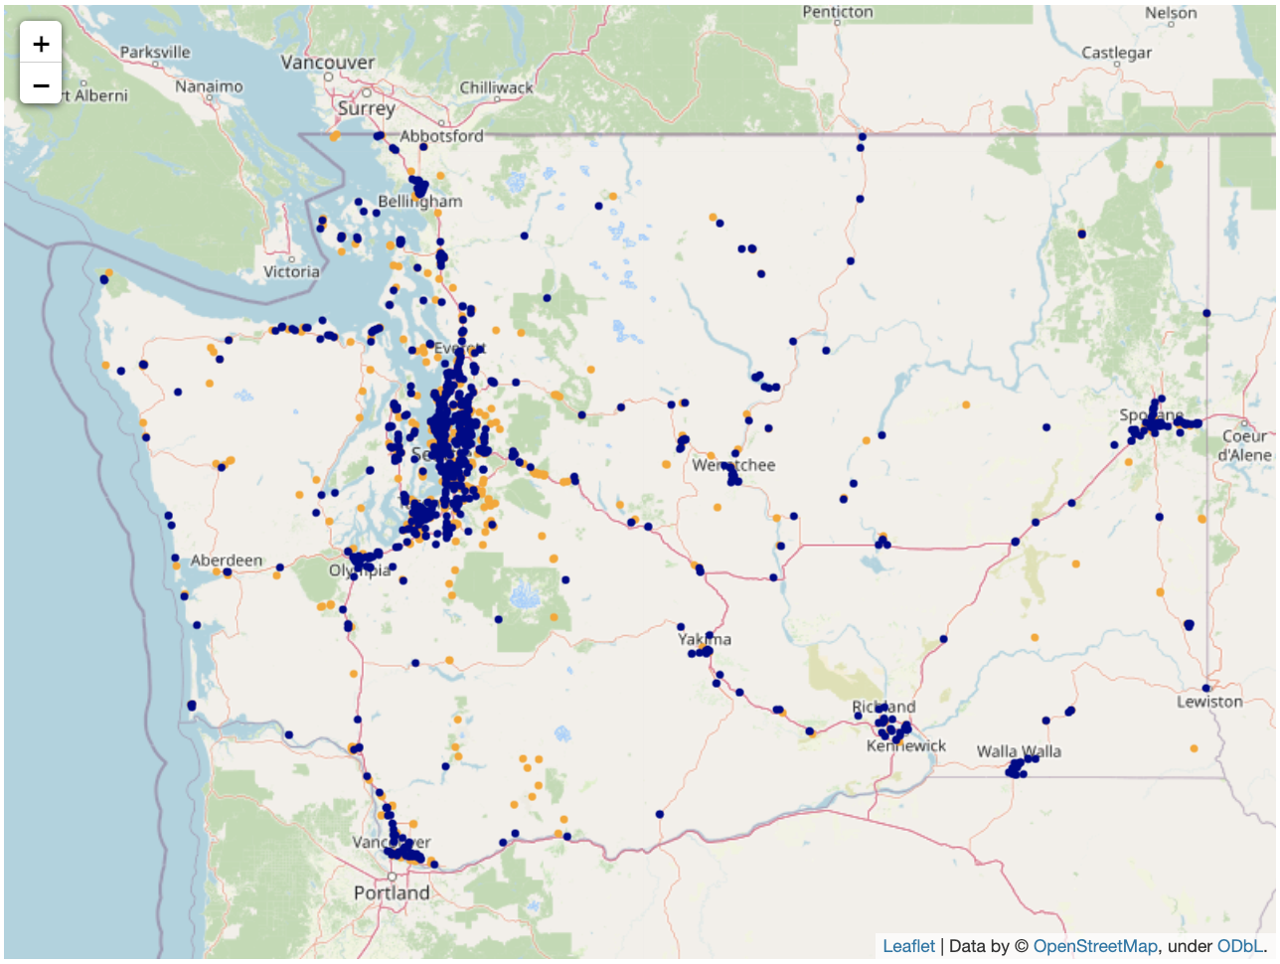
Project Recap: EDA - opportunities exist to build EV chargers around tourism locations
1
: EV charging stations
: Tourism locations
Tourism locations¹ are potential locations for EV charging stations because it…
shows where people may be willing to spend their time for several hours
is reachable from electricity
may be located in rural area between two cities
Some tourism locations without current EV charging stations are along major routes (mainly I-5) with higher traffic identified previously
1. Tourism locations include tourist attractions, artworks and entertainments (e.g. theaters, casino, community center, etc.)

Slide 8
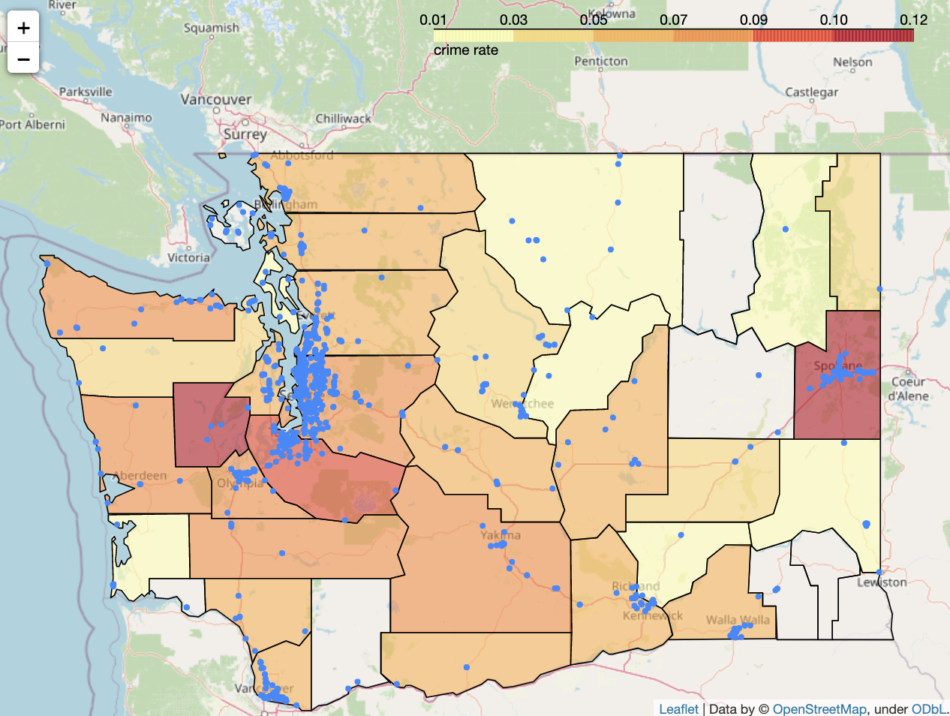
Project Recap: EDA - rural areas has comparably lower crime rate
1
Crime rate (total crimes¹ / population) indicates the dangerousness of the neighborhood in specific counties², which may affect the willingness of the traveller to leave their EVs in some areas
: EV charging stations
Most of current EV charging stations are not located in high crime rate areas, except some crowded charging stations in Spokane
Assumed ideal places for EV chargers discussed in previous slides are mostly located in low crime areas
1. Crime counts includes violent, murder, repel, robbery, assult, property crime, bulglary, larceny theft, motor theft and arson.
2. Note that original data is in city-level, here we generalized it to counties so there may be biases when seeing a whole county as “high crime rate”

Slide 9
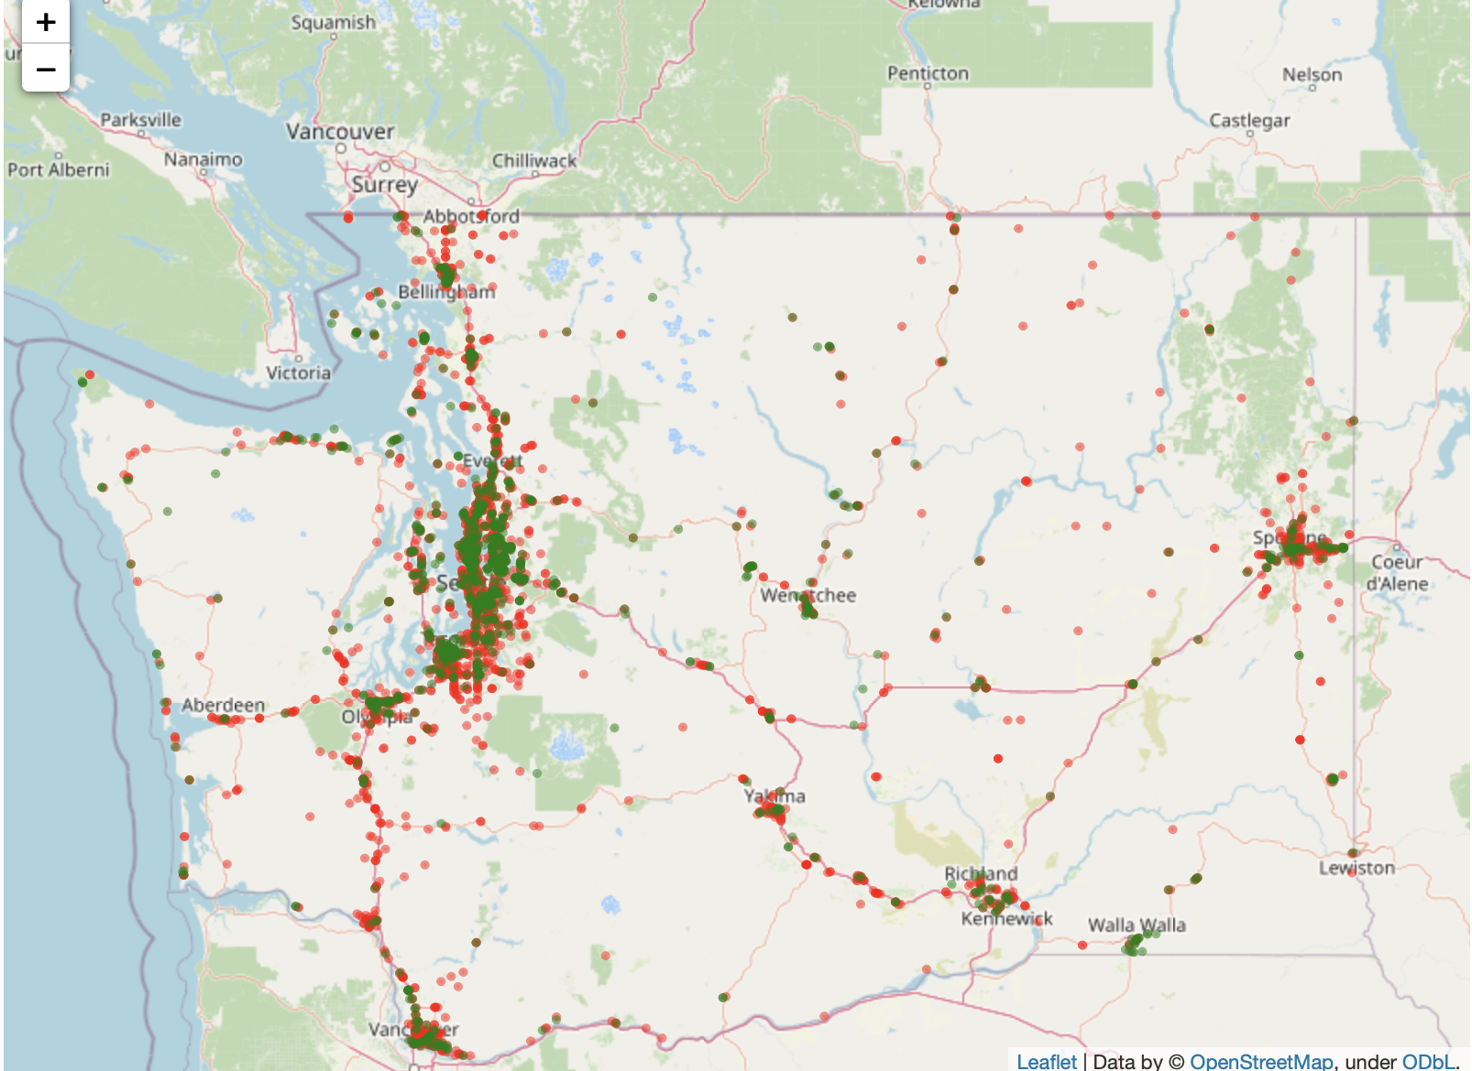
Project Recap: EDA - gas station locations help indicate the electricity accessibility in rural areas
1
Gas chargers and convenience stores in gas stations need to be powered by electricities, so the location of gas stations tells the electricity accessibility
: EV charging stations
: Current gas stations
Most current EV Charging Stations overlap with gas stations in city areas but not along rural routes
Our proposed EV charging station areas shows gas station presence, which indicates that e-grid can reach those areas

Slide 10
Project Recap - data combination for modeling
1
Data entry:
gas stations
name
latitude
longitude
1. Traffic
2. Highway exits
Average traffic counts within 5 miles / 10 miles of driving distance
Max traffic counts within 5 miles / 10 miles of driving distance
Route distance to closest highway exit (only available for locations within 5-mile width of highway corridor)
3. EV chargers
4. Attractions
1 data file
Distance to closest EV station
# of EV stations within 2 miles, 5 miles, 10 miles, 20 miles, 50 miles of driving distance
Attraction counts within 1 mile / 5 miles of driving distance
Closest attraction to each gas station and its distance
5. Crime
6. Natural risk index
Total crime count in the county where the gas station is located
Risk index in the county where the gas station is located

Slide 11
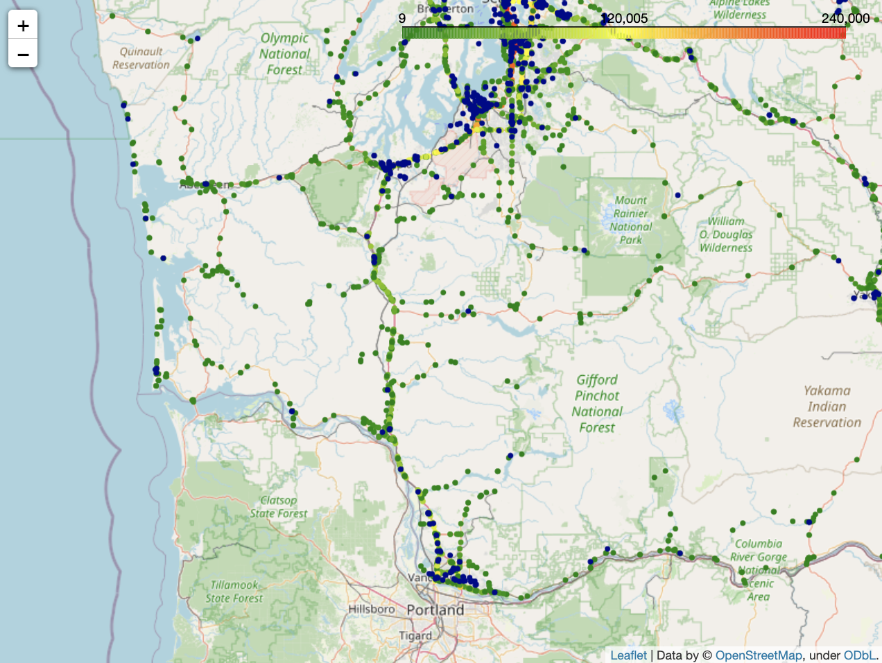
Project Recap: initial modeling focuses on I-5 south area
Initial Modeling area focuses on I-5 Route (Olympia - Vancouver), then expand to other highways
1
: EV charging stations
: annual average daily traffic
I-5

Slide 12
Project Recap: from last week
1
Action items:
Optimization: build optimization model with defined objective function and constraints for selected area
Transfer learning: define criteria to fairly assigned census tracts to training, validation, testing set

Slide 13
Modeling Deep Dive: Classification
2
Idea: use a supervised ML model to give a rough baseline EV charging station locations using gas station location
Based on our current gas station and EV station data, in our selected area (I-5 south), which gas stations can be chosen as locations to place EV chargers
Target
Within 20m precision, whether there is a EV station for each gas station location (whether the location is possible to place EV station)
1 - there exists a matched EV station
0 - there isn’t a matched EV station
Data Preprocessing
Missing data in risk index & crime rate due to lack of records
risk index: fill with average
crime rate: fill with minimum
Remove highly correlated and unuseful features (including id, name, lat/long, etc).
Drop if correlation > 0.8
17 features remaining
Used SMOTE to balance target
Data
Training & validation: all gas stations except ones near I-5 south
Testing/deployment: gas stations near I-5 south
Features
2711 gas stations with 57 features
Imbalanced target
63% unmatched gas stations (0)
37% matched gas stations (1)
Evaluation Metrics
Recall: % of predicted matched among all real matched
Average Precision: averaged accuracy on 1s and 0s
AUROC: provides an aggregate measure of model performance
Notes:
Idea: make good use of the distribution of current gas stations and EV stations
Use a ML model to give a baseline idea: based on our current locations, in our selected area (I-5 south), which gas station can be a location to place EV chargers
Target - use geohash with precision = 8 (20m error on axis) to categorize each gas station and EV station together, match them with geohash encoding
Data - gas stations near i-5 south don’t have target
Feartues
SMOTE: adds synthetic interpolated samples to minority class -> same # of 0 & 1s
our dataset is not too large so creating more data works fine
Evaluation Metric
Recall: our cost of false negative (predict actual matched location as unmatched) is high

Slide 14
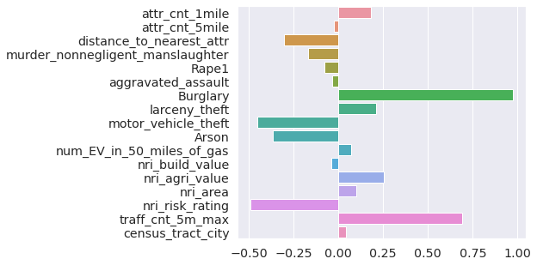
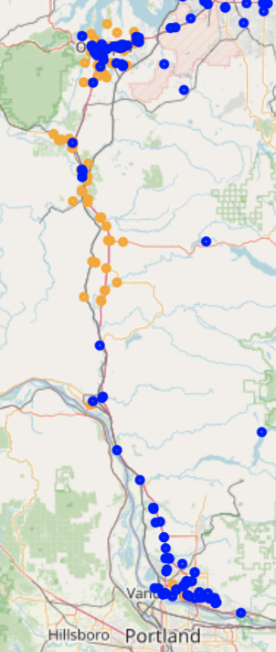
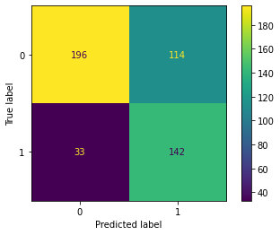
B. Logistic Regression achieved ~80% accuracy on validation data
2
Comparatively small dataset
: Existing EV charging location
Binary target
Feature Importance
: Model suggested EV charging location
Easy to interpret
Logistic Regression
Model Deployment
Predicted EV charging locations are outside of existing EV charging
locations
Recall: ~80%
Average Precision: ~80%
AUC: ~80%
Better model performance compared to tree-based models
Model Performance
We don’t care whether the model predicted unmatched gas stations as EV because our goal is to have more EV stations
Notes:
Feature importance result corresponds to our expectation - crime rate, natural risk index and traffic

Slide 15
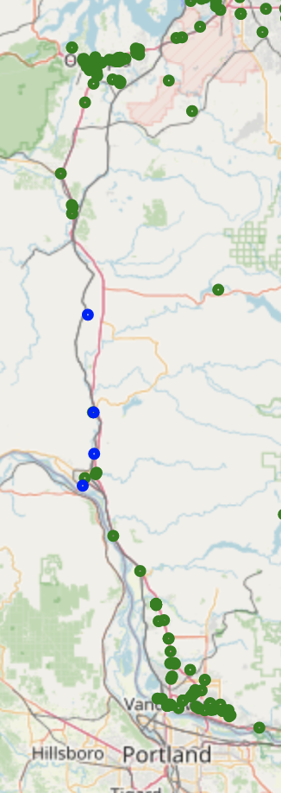
Modeling Deep Dive: Optimization
3
Try the optimization on a specific region with a set of simplified objective function and constraints
Based on our current gas station and EV station data, in our selected area (I-5 south), which gas stations can be chosen as locations to place EV charging stations
Objective function
Maximize traffic count covered
: Existing EV charging location
Constraints
(still deciding)
Distance to highway exit < 1 miles
# of EV stations within 2 mile distance < 3
# of EV stations within 20 mile distance < 10
NRI risk rating is not Very High
New proposed locations are at least 5 miles apart
: Suggested EV charging location
Improvements
traffic count covered by each charger of different types
Cost of charging station and each additional charger
Objective function Minimize cost and maximize covered traffic
Notes:
Minimize cost (# ev stations * ev station cost + # of chargers * charger cost)

Slide 16
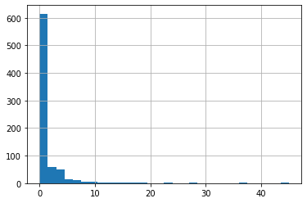
Modeling Deep Dive: Transfer Learning
# of EV stations in urban areas
4
Optimal Solution: Based on model trained on urban/suburban area, try to generalize it onto rural area
Current status: XGBoost Regressor as Baseline Model
It is impossible to find a well pretrained model using the same features we have
Target
The optimal number of EV charging stations in rural areas
Data Preprocessing
Missing data in risk index & crime rate due to lack of records
>> same as how classification is preprocessed
Group by census tract index
create new features (such as # of attraction)
Remove unuseful features (including id, name, lat/long, etc).
Data
Training & validation: census tract categorized as city/suburban
Testing/deployment: census tract categorized as rural
Features
1045 valid census tract area with 35 features
The true values are highly skewed even after log transformation
Evaluation Metrics
MSE: estimator measured the average of the squares of the errors
R-square: proportion of the variation in Y that is predictable from the X

Slide 17
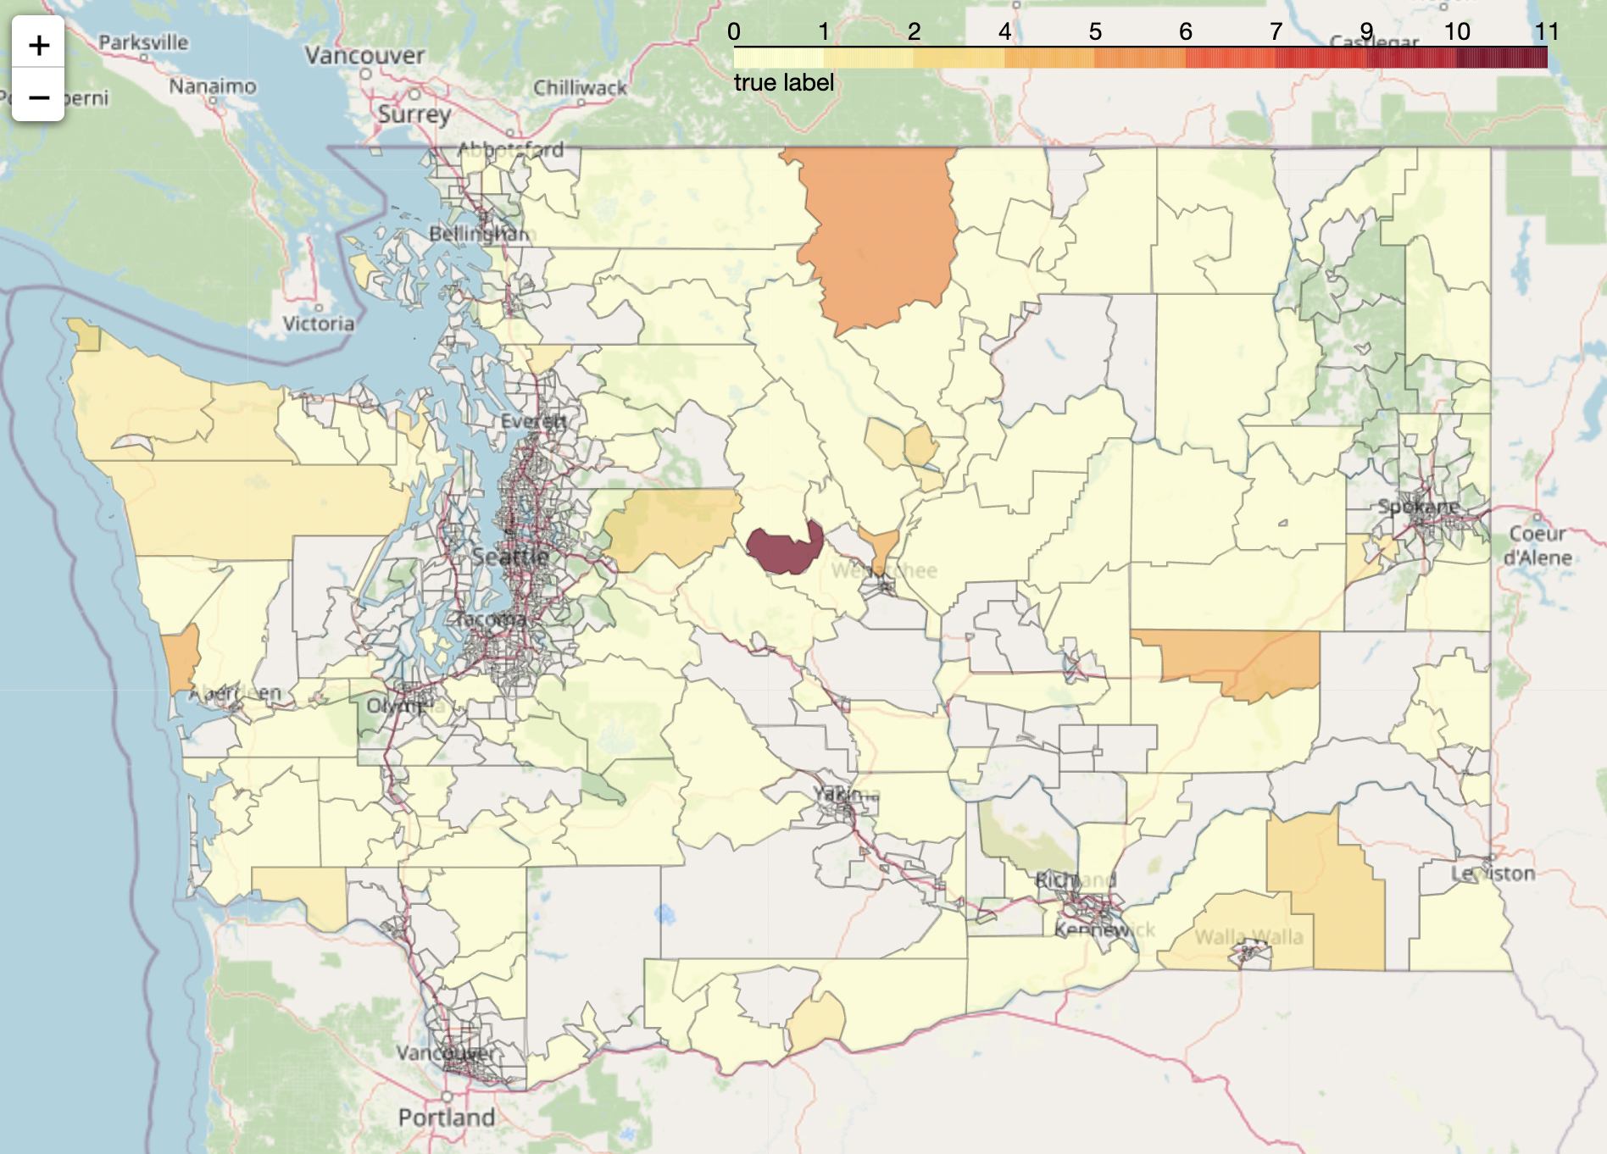
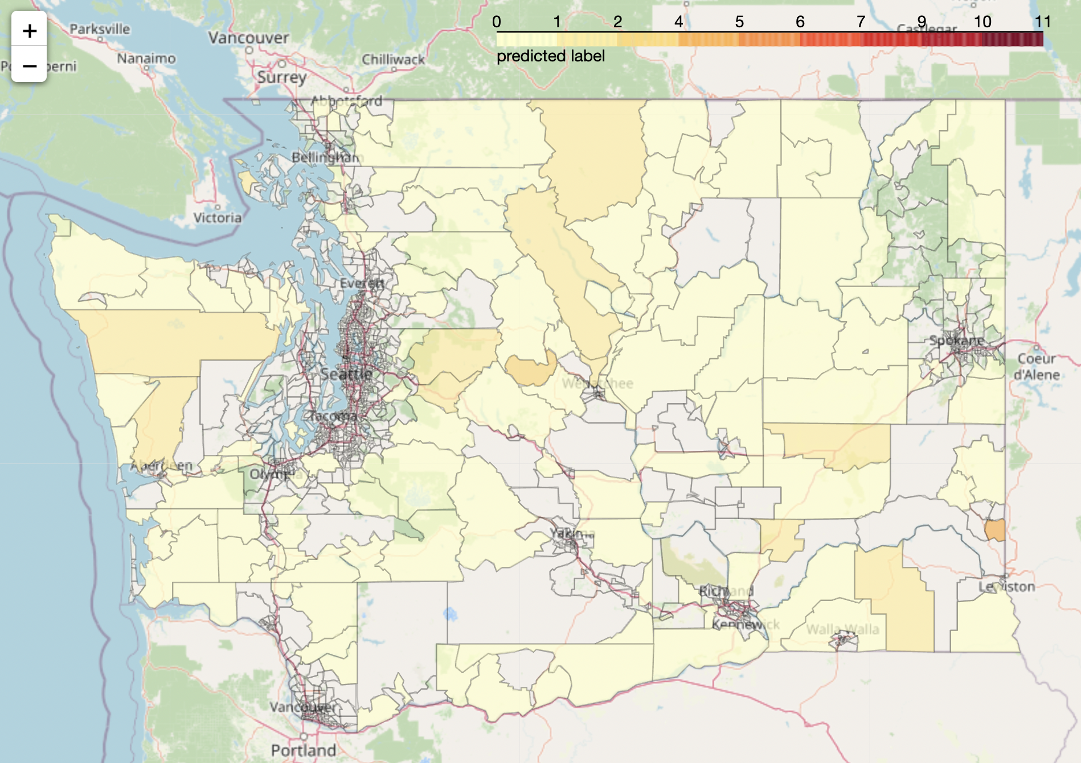
Modeling Deep Dive: Transfer Learning
4
Problems of Baseline Model
It captures the area, because we have high correlated feature: # of EV stations near gas stations
The predicted number is relatively small, mostly < 2
We didn’t have proposed number of EV charging stations for each census tract/city
Ground Truth
Predictions

Slide 18
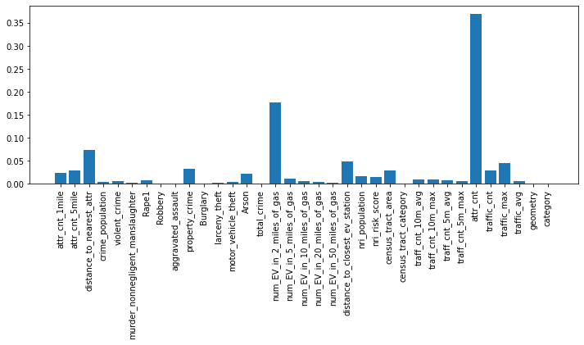
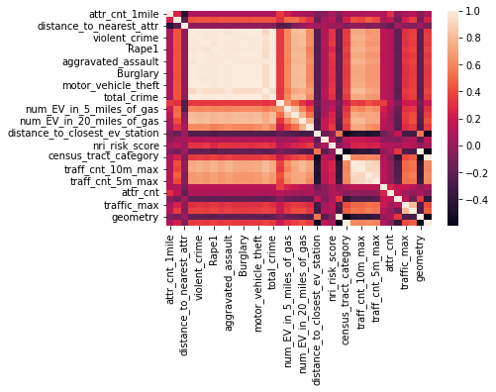
Modeling Deep Dive: Transfer Learning
4
Crime populations are highly correlated with each other >> feature selection
# of Attraction in that area has the highest importance
# of EV stations in the area
Feature Engineering:
Even the number of EV charging stations around the gas stations is correlated with current number of EV charging stations, it is still an important concern of business implementation.
The ground truth can be interpreted as number of exist demand
Notes:
Variables consider # of chargers(>= level 2) within range 20 mile?

Slide 19
Next Steps
5
Action items:
Classification: fine-tune the model & try to see if applicable on other area
Optimization: improve objective function to consider cost and traffic count per charger
Generalization (Transfer Learning): how to meaningfully select the features
Notes:
Ask midpoint readout for next week?

Slide 20
Appendix

Slide 21
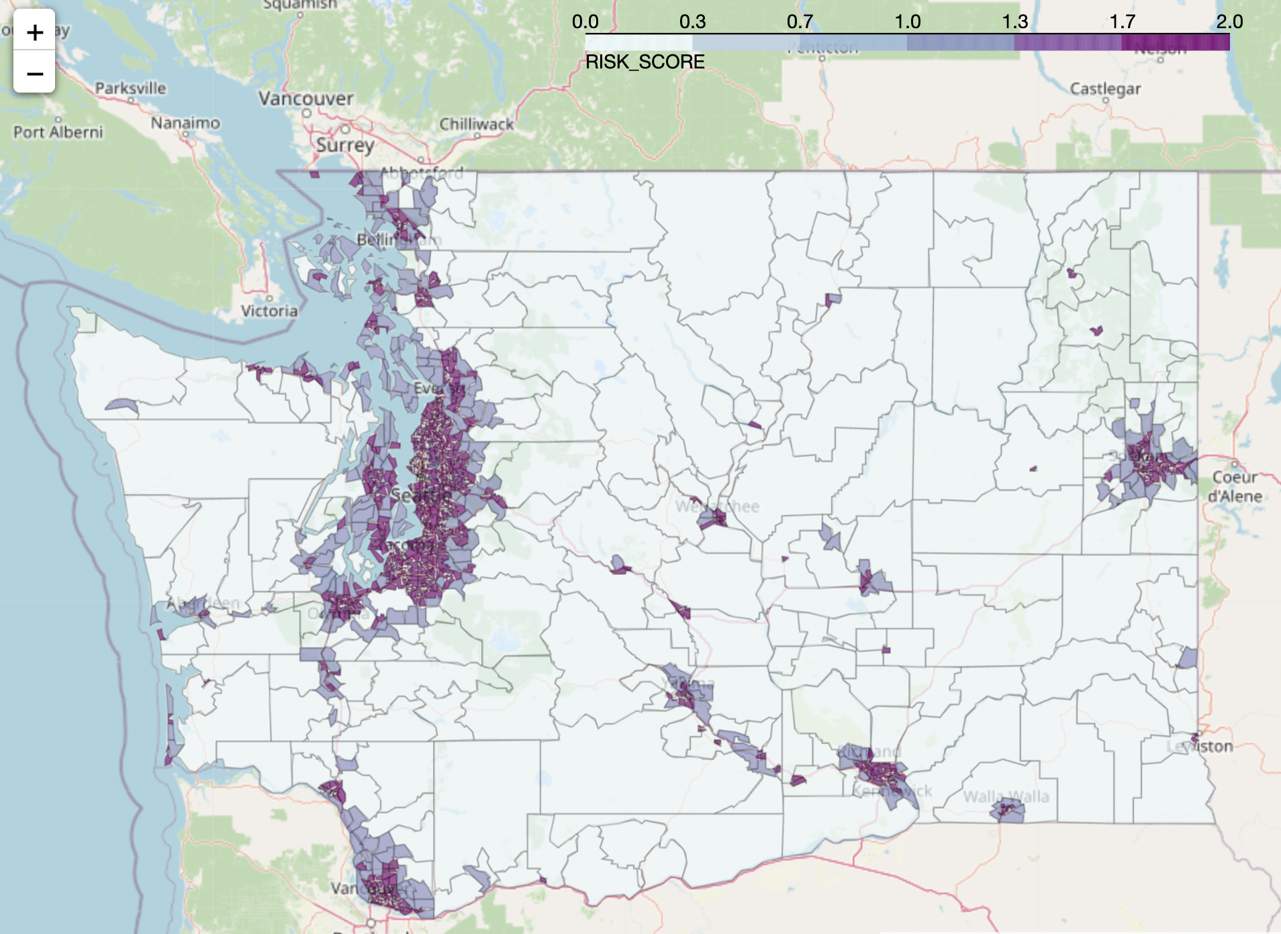

Slide 22
